Slide 1

Prediction of Sea Ice Edge by Using Image Processing Techniques
Pravin Kumar Rana
Indian Institute of Technology
Kharagpur-721302
India

Slide 2
Outline
Problem
Approach
Result & Discussion
Future work

Slide 3
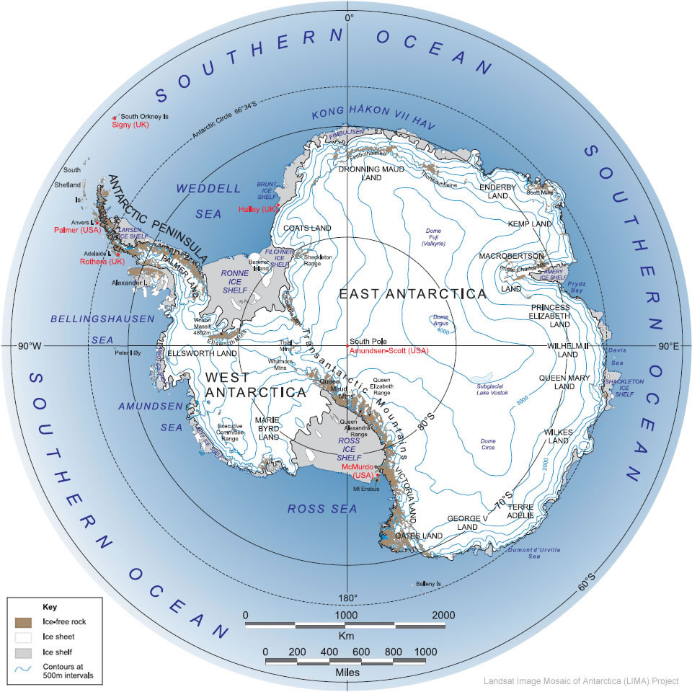
Antarctica
The southern most icy continent of the world surrounding the south pole is called Antarctica.
Antarctica is located between the latitudes of approximately 65⁰ S and 90⁰ S
Antarctica is called pulsating continent because its ice pack grows from an area of 2.6X10⁶ km² by March-end (end of southern summer) to about 18.8X10⁶ km² by September-end (end of southern winter)

Slide 4
Salient Features of Antarctica
Fifth largest continent about 14X10⁶ km²
Mean Surface elevation is over 2000m
Lowest temperature recorded -89 ⁰C
Wind velocity up to 200 km/h
About 10% of the cost is rocky
The driest continent in the world
The highest point in the continent is Vinson Massif with height of 5140 m
Locked in the Antarctica land mass is 90% of the world’s ice cover and 70% of the global fresh water
The 10% of Antarctica is free of ice
The thickness of ice on the remaining 90% of the continent is 0.6-4.5 km
Antarctica started forming at least 50X10⁶ years ago

Slide 5
Problem
Prediction of pulsating nature of Sea Ice Edge over the Antarctica

Slide 6
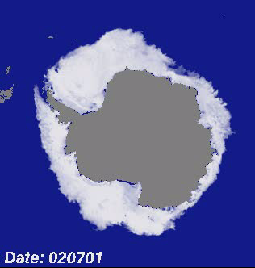
Pulsating continent : Antarctica
Pulsating Antarctica: Seasonal Variation of Antarctica Sea Ice Edge
from 1st July 2002 to 1st July 2005

Slide 7
Why Antarctica Sea Ice Edge?
Antarctic sea-ice cover plays an important role in the earth’s climate, primarily by insulating the ocean from the atmosphere and increasing the surface albedo.
Sea-ice formation and the accompanying convective processes are the main driving force for the global thermohaline circulation.
Densification of sea water by brine rejection as a result of intensive freezing is strongest in open water areas and the bottom-water formation.
Sea-ice edge is a potential indicator of climate change.
Fishing and commercial shipping activities as well as military submarine operations need reliable ice edge information for safety purposes.

Slide 8
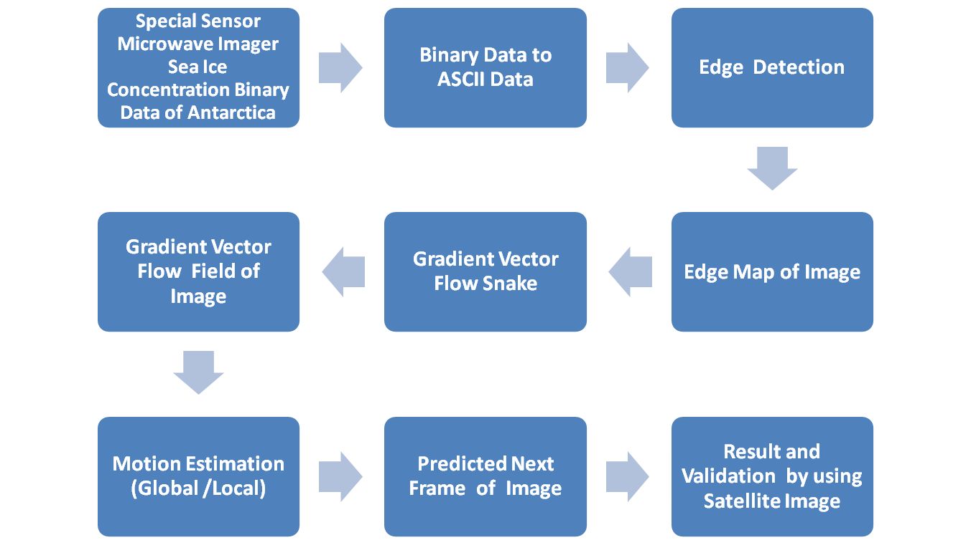
Approach

Slide 9
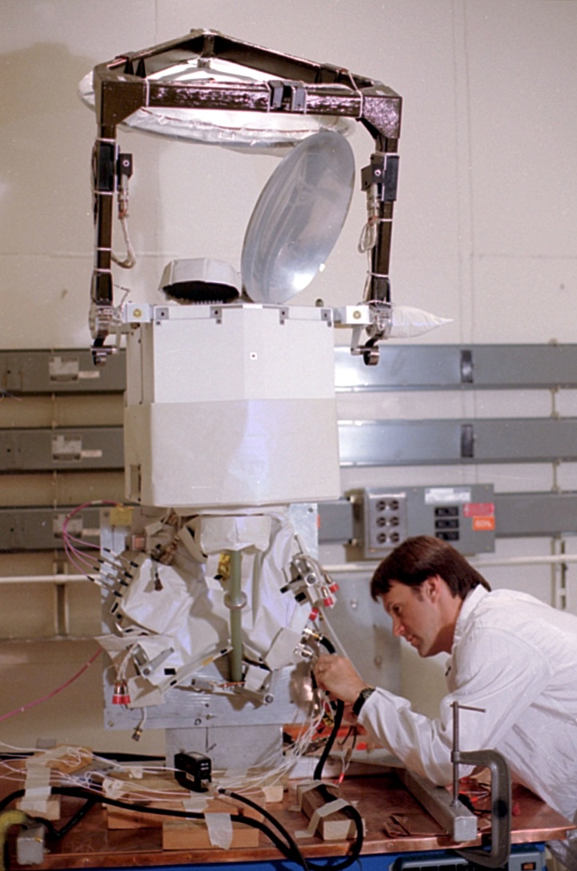
Sea Ice Concentration Data
Special Sensor Microwave/Imager
The sea ice concentration derived from the Special Sensor Microwave/Imager (SSM/I) using Bootstrap Algorithm with daily varying tie-points.
The sea ice concentration is gridded on polar stereographic projection with 25km x 25 km resolution
It is provided in binary two-byte integer format.
Temporal coverage: 1987 to till date, Daily and monthly
Bootstrap Algorithm: http://nsidc.org/data/docs/
daac/bootstrap/index.html
Data Source :The National Snow and Ice Data Center
(http://www.nsidc.org)

Slide 10
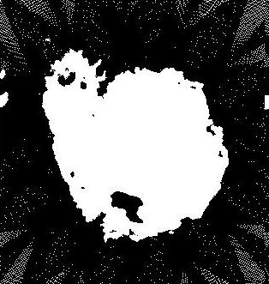
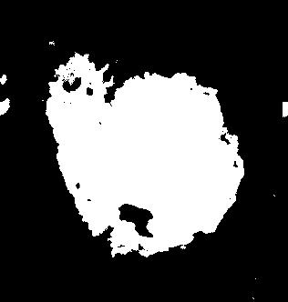

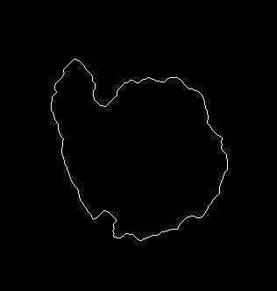
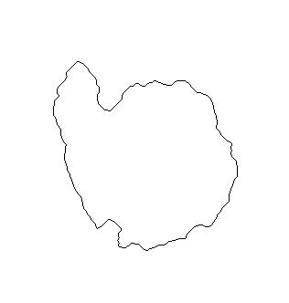
Different Steps to getting edge by using MATLAB

Slide 11
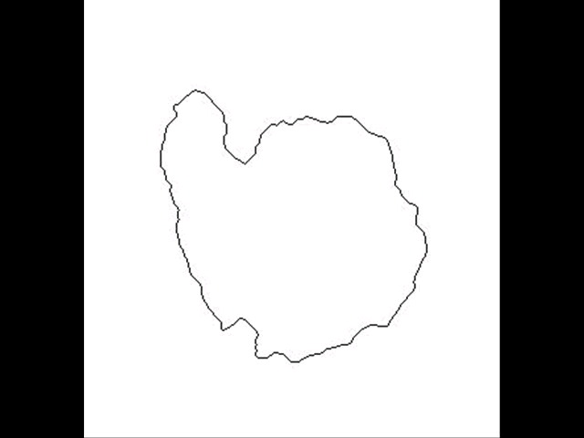
Variation in Sea Ice edge in Antarctica in 2006

Slide 12
Gradient Vector Flow Snake
Snake (or Active Contour ) are cures defined within an image domain that can move under the influence of the internal forces coming from within the cures itself and external forces computed form the image data
An energy minimizing spline guided by external constraint forces and pulled by image forces toward features.
Model is always minimizing its energy functional and therefore exhibits dynamic behavior : Active Contour Model.
The way the contours slither in the model while minimizing their energy is know as Snake Model.
The snake’s energy depends on its shape and location
Snakes can be closed or open
GVF snake is active contour which use the gradient vector field as a external force.

Slide 13
Applications of Snake
Edge Detection
Motion Tracking
Shape Modeling
Image Segmentation
Pattern Recognition

Slide 14
Why Gradient Vector Flow Snake?
Insensitivity to initialization
Large capture range
An ability to progress into boundary concavities
Detects shapes with boundary concavities
Does not need prior knowledge about whether to shrink, or expand towards boundary

Slide 15
GVF Snake Model
A snake is a curve X(s)=[x(s),y(s)],s Є [0,1] that moves through the spatial domain of an image to minimize the energy functional
E_{snake} = ∫₀¹ [E_{internal} (X(s)) + E_{external}(X(s))]ds
where E_{internal} is the internal energy and E_{external} is the external energy of the snake, respectively

Slide 16
Internal Energy
The internal energy for Snake can be written as
E_{Internal} = [ (α(s)|X’(s)|² + β(s)|X’’(s)|²) ] / 2
Elasticity Rigidity
Note : where X’ and X’’ are the 1st and 2nd derivatives of the snake with respect to s and α(s), β(s) specify the elasticity and rigidity of the snake, respectively and are often independent of s.

Slide 17
External Energy
The external energy computed from the image data is a weighted combination of energies which attract the snake to lines or edges Image data
For a Gray-level Image I(x, y)
E¹_{external} = -|∇I(x, y)|²
E²_{external} = -|∇[G_{σ}(x, y)*I(x, y)|²
For a line drawing (black on white) Image I(x, y)
E³_{external} = I(x, y)
E⁴_{external} = G_{σ}(x, y)*I(x, y)
where G_{σ} is the 2D Gaussian function with standard deviation σ and ∇ is the gradient operator

Slide 18
Implementation
The process of my implementation:
1 Import an image
2. Initialize the snake for the image
3. Compute the edge map of the image
4. Input the edge map to the GVF solver
5. Deforms the snake

Slide 19
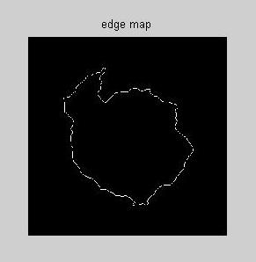
Edge Map
Edge map f(x , y) derived from the image I(x , y) having the property that it is larger near the image edges
f(x , y) = -E^{(i)}_{external}(x , y)
i=1,2,3, or 4.

Slide 20
Gradient Vector of Edge Map
General Properties:
Effects:
These vectors pointing toward the edges, which are normal to the edges at the edges.
These vectors generally have large magnitudes only in the immediate vicinity of the edges.
In homogeneous regions, where I(x, y) ≈constant, Δf ≈ 0.
A snake initialized close to the edge will converge to a stable configuration near the edge.
The capture range will be very small, in general.
In homogeneous regions will have no external forces whatsoever.
Notes:
: Now consider how these properties affect the behavior of a traditional snake when the gradient of an edge map is used as an external force.
These last two properties are undesirable. Our approach is to keep the highly desirable property of the gradients near the edges, but to extend the gradient map farther away from the edges and into homogeneous regions using a computational diffusion process. As an important benefit, the inherent competition of the diffusion process will also create vectors that point into boundary concavities.

Slide 21
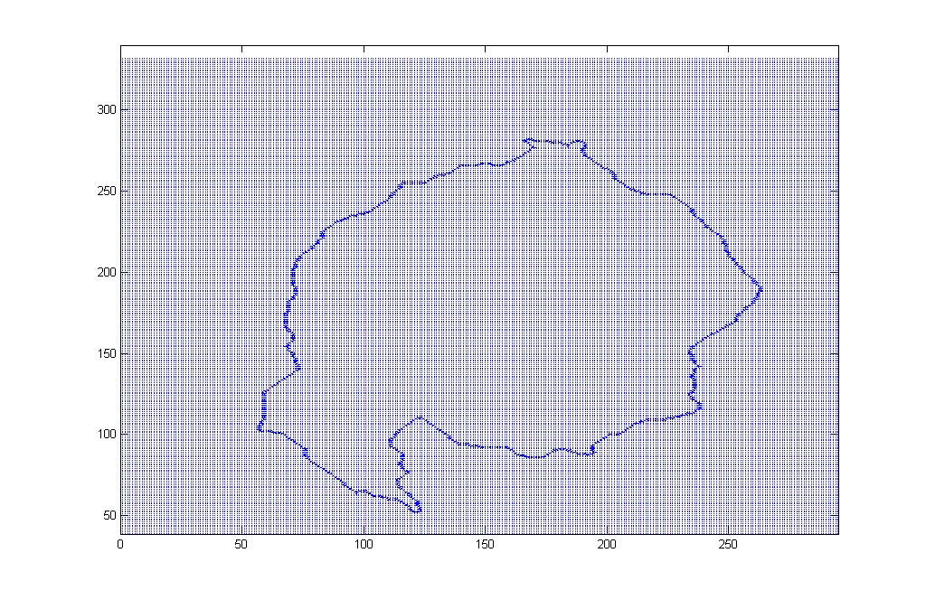
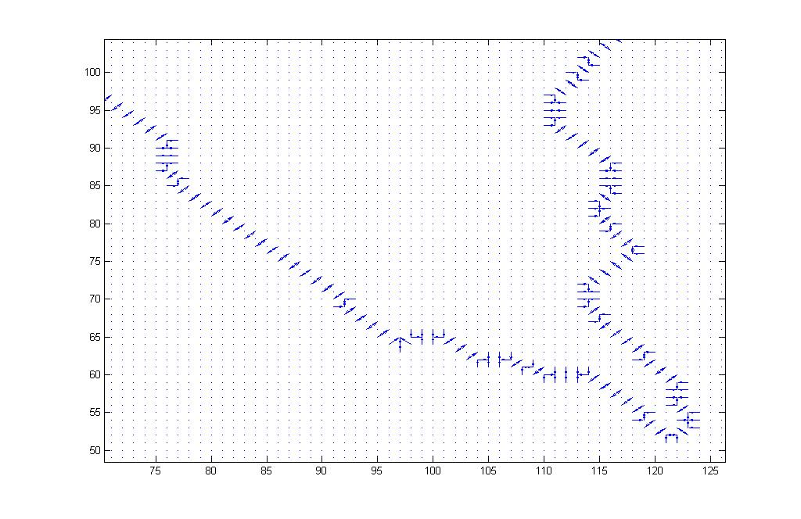
Gradient of the Edge map

Slide 22
Gradient Vector Flow
The GVF field is defined to be a vector field
V(x , y) = [u(x , y), v(x , y) ]
V(x , y) is defined such that it minimizes the energy functional
ε=∫∫μ(u_{x}²+u_{y}²+v_{x}²+v_{y}²) +|∇f|²|V - ∇f|²dxdy
where f(x , y) is the edge map of the image and μ is noise parameter
Using the calculus of variations, GVF field can be obtained by solving following Euler equations
μ∇²u - (u - f_{x} )(f_{x}² + f_{y}²)=0
μ∇²v – (v - f_{y} )(f_{x}² + f_{y}²)=0
where ∇² is the Laplacian operator and f_{x} and f_{y} are the partial derivative of the edge map

Slide 23
Numerical Implementation
Equations can be solved by treating gradient vector flow u and v as functions of time and to set up the iterative solution, we can write
u_{i,j}^{n+1} = (1- b_{i,j}∆t)u_{i,j}^{n} + r(u_{i+1,j}^{n} + u_{i,j+1}^{n} + u_{i-1,j}^{n} + u_{i,j-1}^{n} - 4u_{i,j}^{n}) + c_{i,j}¹∆t
v_{i,j}^{n+1} = (1- b_{i,j}∆t)v_{i,j}^{n} + r(v_{i+1,j}^{n} + v_{i,j+1}^{n} + v_{i-1,j}^{n} + v_{i,j-1}^{n} – 4v_{i,j}^{n}) + c_{i,j}²1∆t
where the indices i, j, and n correspond to x, y and t respectively,
r = {μ∆t /∆x∆y}≤(1/4) and
b(x, y) = fx (x, y)² + fy(x, y)²
c¹=b(x, y)*fx(x, y)
c²=b(x, y)*fy(x, y)

Slide 24
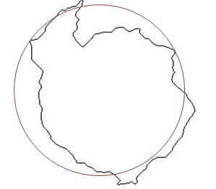
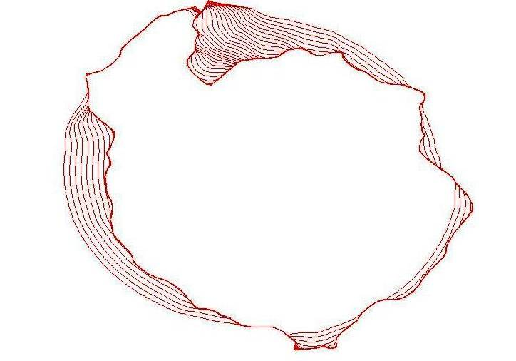
Convergence of a Snake using GVF
external force towards edge
Initial Snake

Slide 25
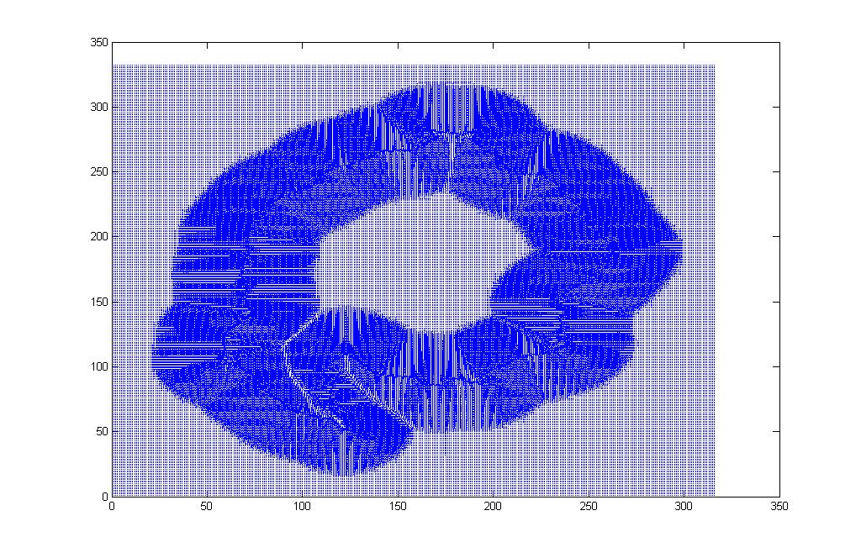
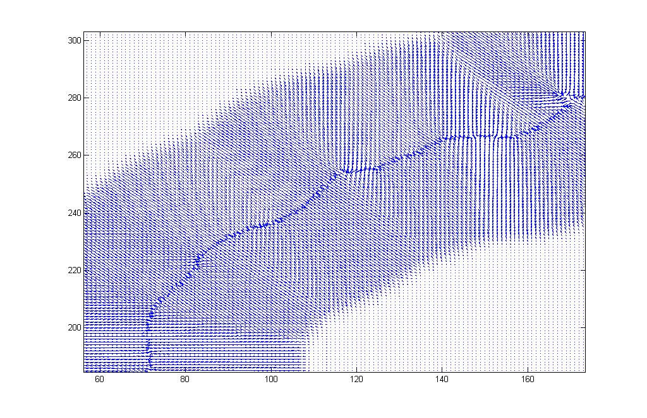
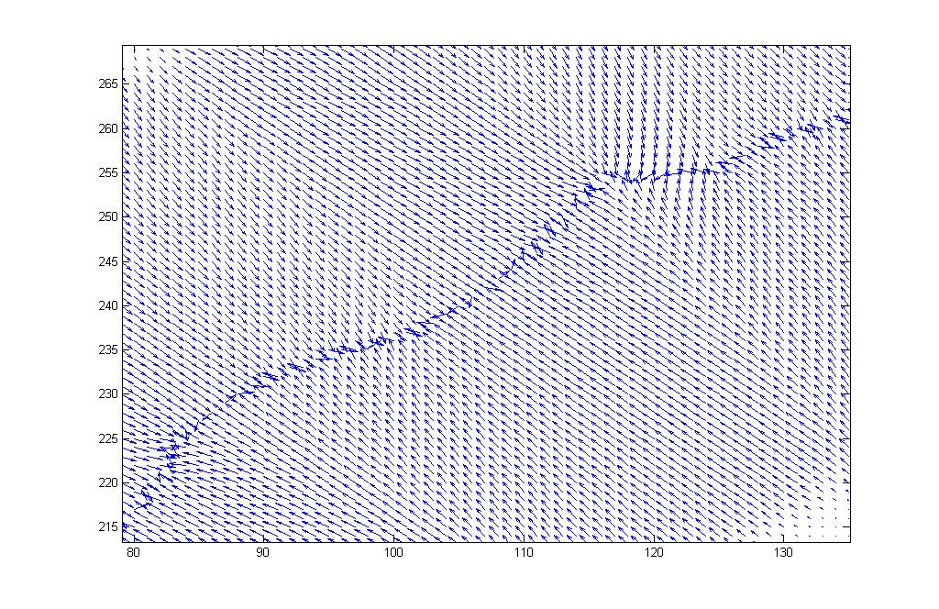
Normalized Gradient Vector Flow Field

Slide 26
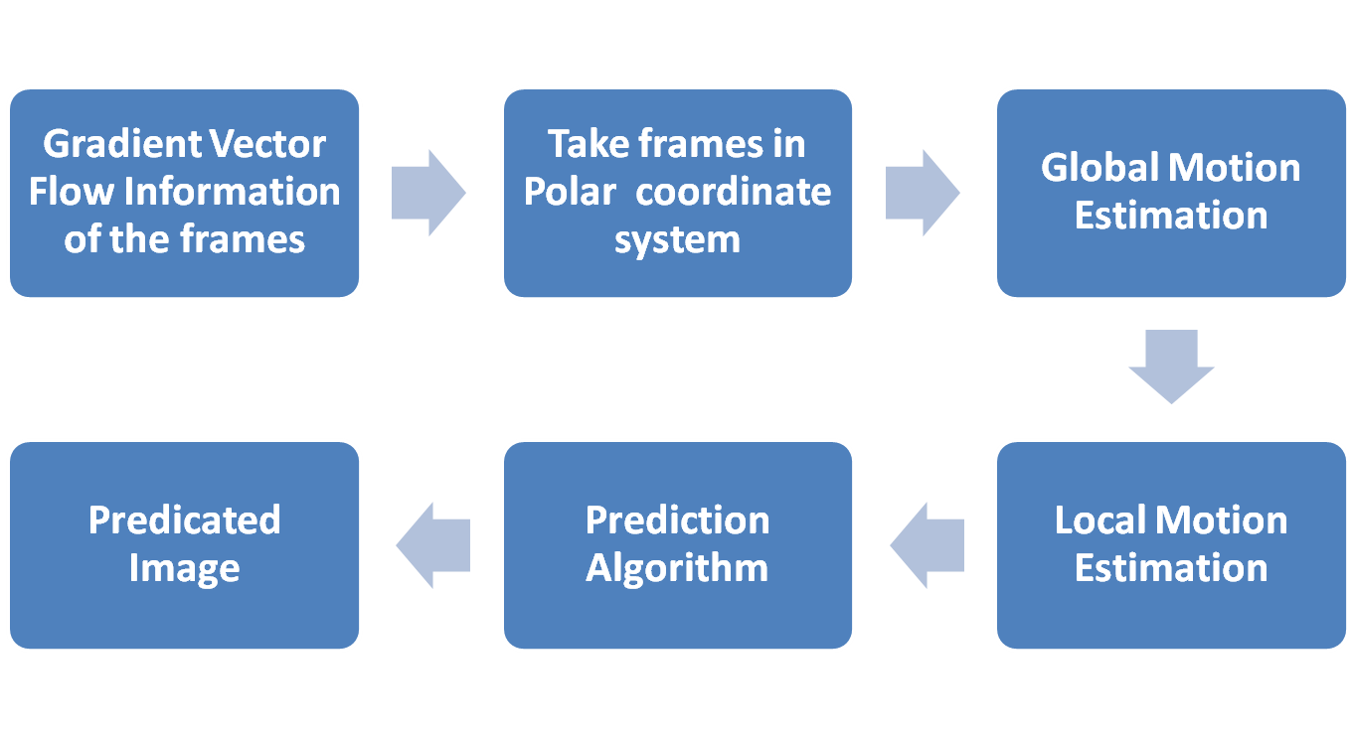
Motion Estimation

Slide 27
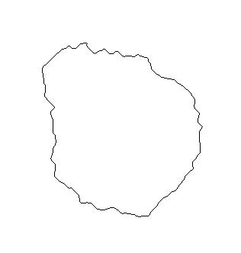
Global Motion Estimation
j
Ф =tan⁻¹ [(i_{u}-i₀)/(j_{v}-j₀)]
O(i₀, j₀)
Where, u=1,2,…332
v=1,2,…316
i

Slide 28
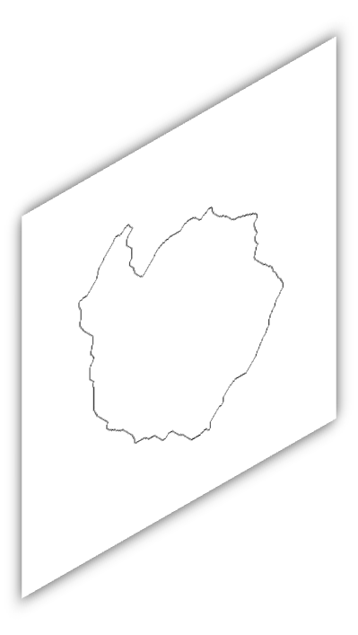
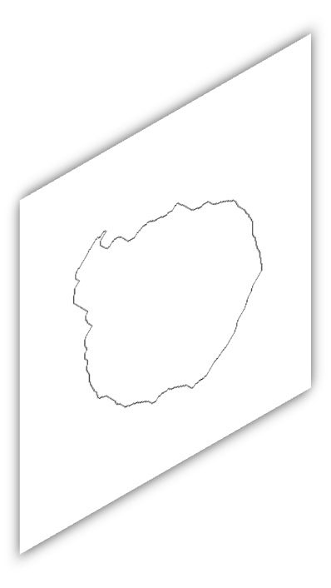
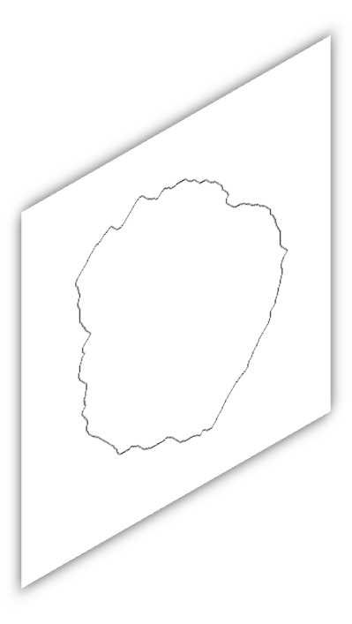
Global Motion Estimation

Slide 29
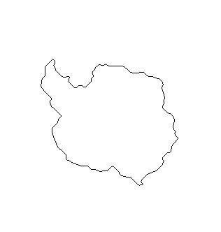
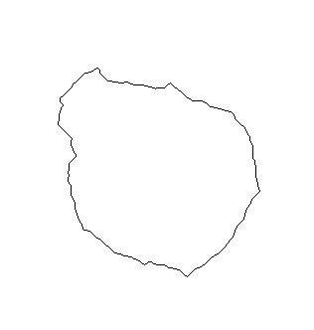
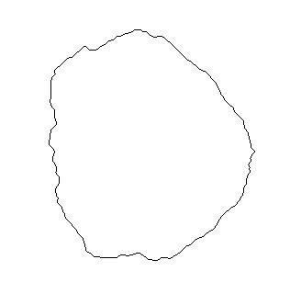
Local Motion Estimation

Slide 30
Result and Discussion
Awaited…

Slide 31
Future Work
Improve reliability of Sea Ice Edge Prediction
Prediction of Random Deformation in Shape
Estimation and Tracking of Ice Bergs Deformation
Prediction of Biological Cell Growth and Decay

Slide 32
Thank You
Email: pravin_k_rana@yahoo.com pkrana@coral.iitkgp.ernet.in
Mobile No.:+919932572930

